Slide 1
Digital Dashboard Capstone
Team Members: Sean Koppenhafer, Jaime Rodriguez,
Chad Thueson, Noah Erickson, Rishal Dass
Notes:
Slide Purpose: Introduce ourselves

Slide 2
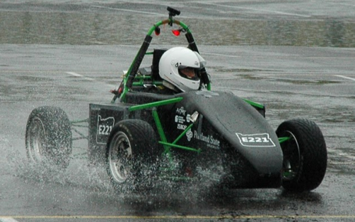
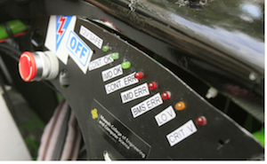
Project Overview
Electric systems add complexity and a traditional LED dash would not suffice
Drivers must be aware of system faults and warnings
A Digital Dashboard must be created to accommodate additional electrical systems
Formula SAE Electric Car
Traditional LED Dashboard
Notes:
Slide Purpose: What did we have to do

Slide 3
Requirements
Size
Price
Features
LCD Screen < 4”
Compact system
$500 Budget
User friendly
Inexpensive reproducibility
Plug and play
Water resistant
Notes:
Slide Purpose: Show requirements linked to decisions

Slide 4
Consideration – Microprocessor
System | Cost | Custom Board | CAN Controller | CAN Library | SPI, I²C, UART, etc
ATMEGA328 | $3 | Yes | No | No | Yes
AT90CAN | $8 | Yes | Yes | Yes | Yes
Arduino Uno | $25 | No | No | No | Yes
Arduino Due | $50 | No | Yes | Yes | Yes
ATSAM3X | $12 | Yes | Yes | Yes | yes
The ATSAM3X was chosen for the following:
Same microprocessor as Arduino Due
CAN library available
ATSAM3X
4DSystems LCD
Digital Dashboard
CAN Communication
Notes:
Slide Purpose: Why we chose the ATSAM3X

Slide 5
Consideration – Screen
Company | Cost | Size | Color | Sunlight Visibility | Software
EarthLCD | $219 | 3.5” | Yes | Yes | Yes
New Haven | $60 | 4.9” | No | Yes | No
Sun LCD | ??? | 3.5” | Yes | Yes | No
4D Systems | $89 | 3.5” | Yes | No | Yes
The 4D Systems Screen was chosen for the following:
Design software available
Affordable full color touchscreen
ATSAM3X
4DSystems LCD
Digital Dashboard
CAN Communication
Notes:
Slide Purpose: Why we decided on the screen

Slide 6
Consideration – Comm. Protocol
Protocol | System Integration | GEVCU Capability | ATSAM3X Compatibility
I²C | Simple | Yes | Yes
SPI | Simple | Yes | Yes
CAN | Moderate | Yes | Yes
Wi-Fi | Complex | Yes | No
The CAN protocol was chosen for the following:
Vehicle components already running on CAN
ATSAM3X
4DSystems LCD
Digital Dashboard
CAN Communication
Notes:
Slide Purpose: why we decided on CAN
CAN was already implemented

Slide 7
System Overview
CAN Buses
GEVCU
Microcontroller
LCD Screen
Power Supply
Notes:
Slide Purpose: Show how the system connects

Slide 8
Printed Circuit Board
Features
Compact size
Inputs
5V or 12V power sources
Outputs
LCD mating header
2-Layer design for easy reflow
Multiple power supply input voltages
Programming port
CAN0 high and low
CAN1 high and low
Based on an Arduino Due
LCD Mating
Header
CAN Inputs
Programming Circuit
12V Supply
Notes:
Slide Purpose: Show off our awesome PCB

Slide 9
Software
Arduino CAN library receives bus data
Messages are interpreted
Update screen with Arduino 4D Systems Library
Notes:
Slide Purpose: Show off our awesome software

Slide 10
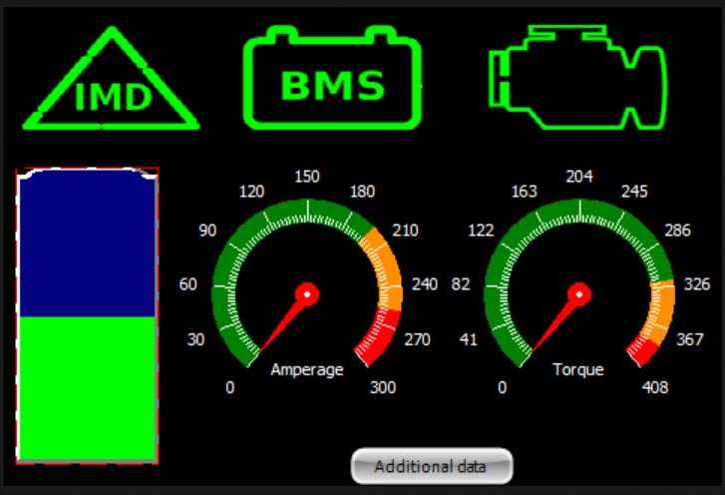
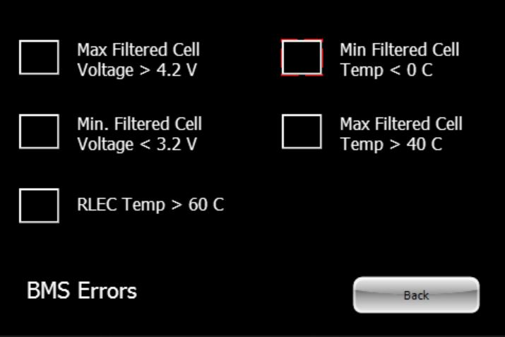
GUI
Created with 4D Systems IDE
Simple design for quick driver interpretation
Touch enabled subscreen buttons
High contrast for viewing in sunlight
Main Screen
BMS Subscreen
Notes:
Slide Purpose: Show GUI decisions

Slide 11
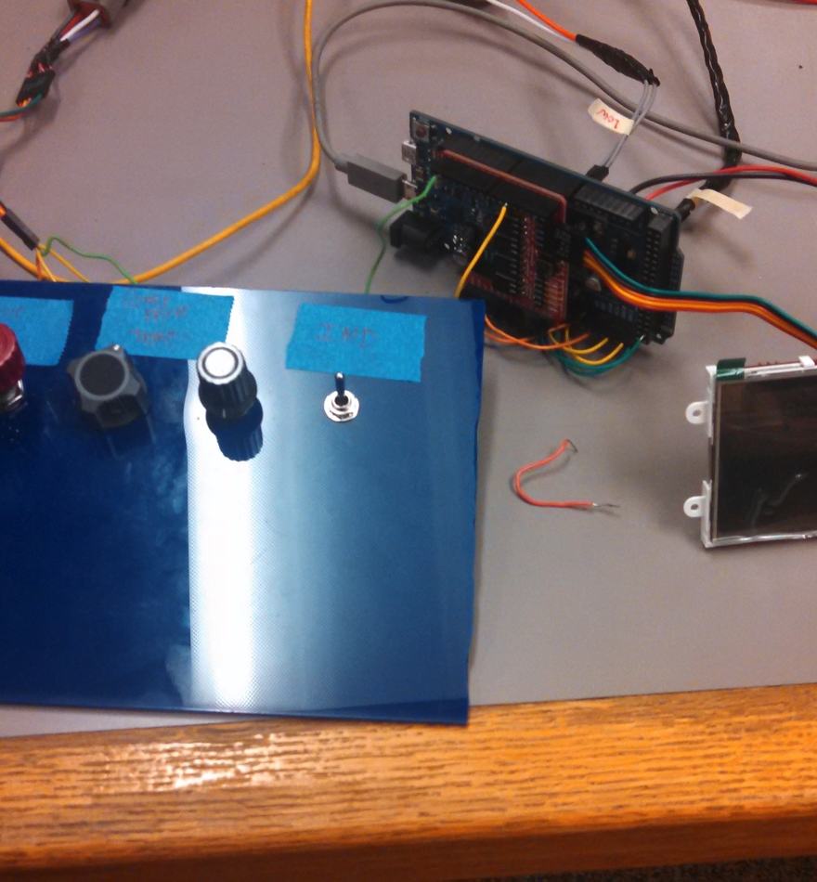
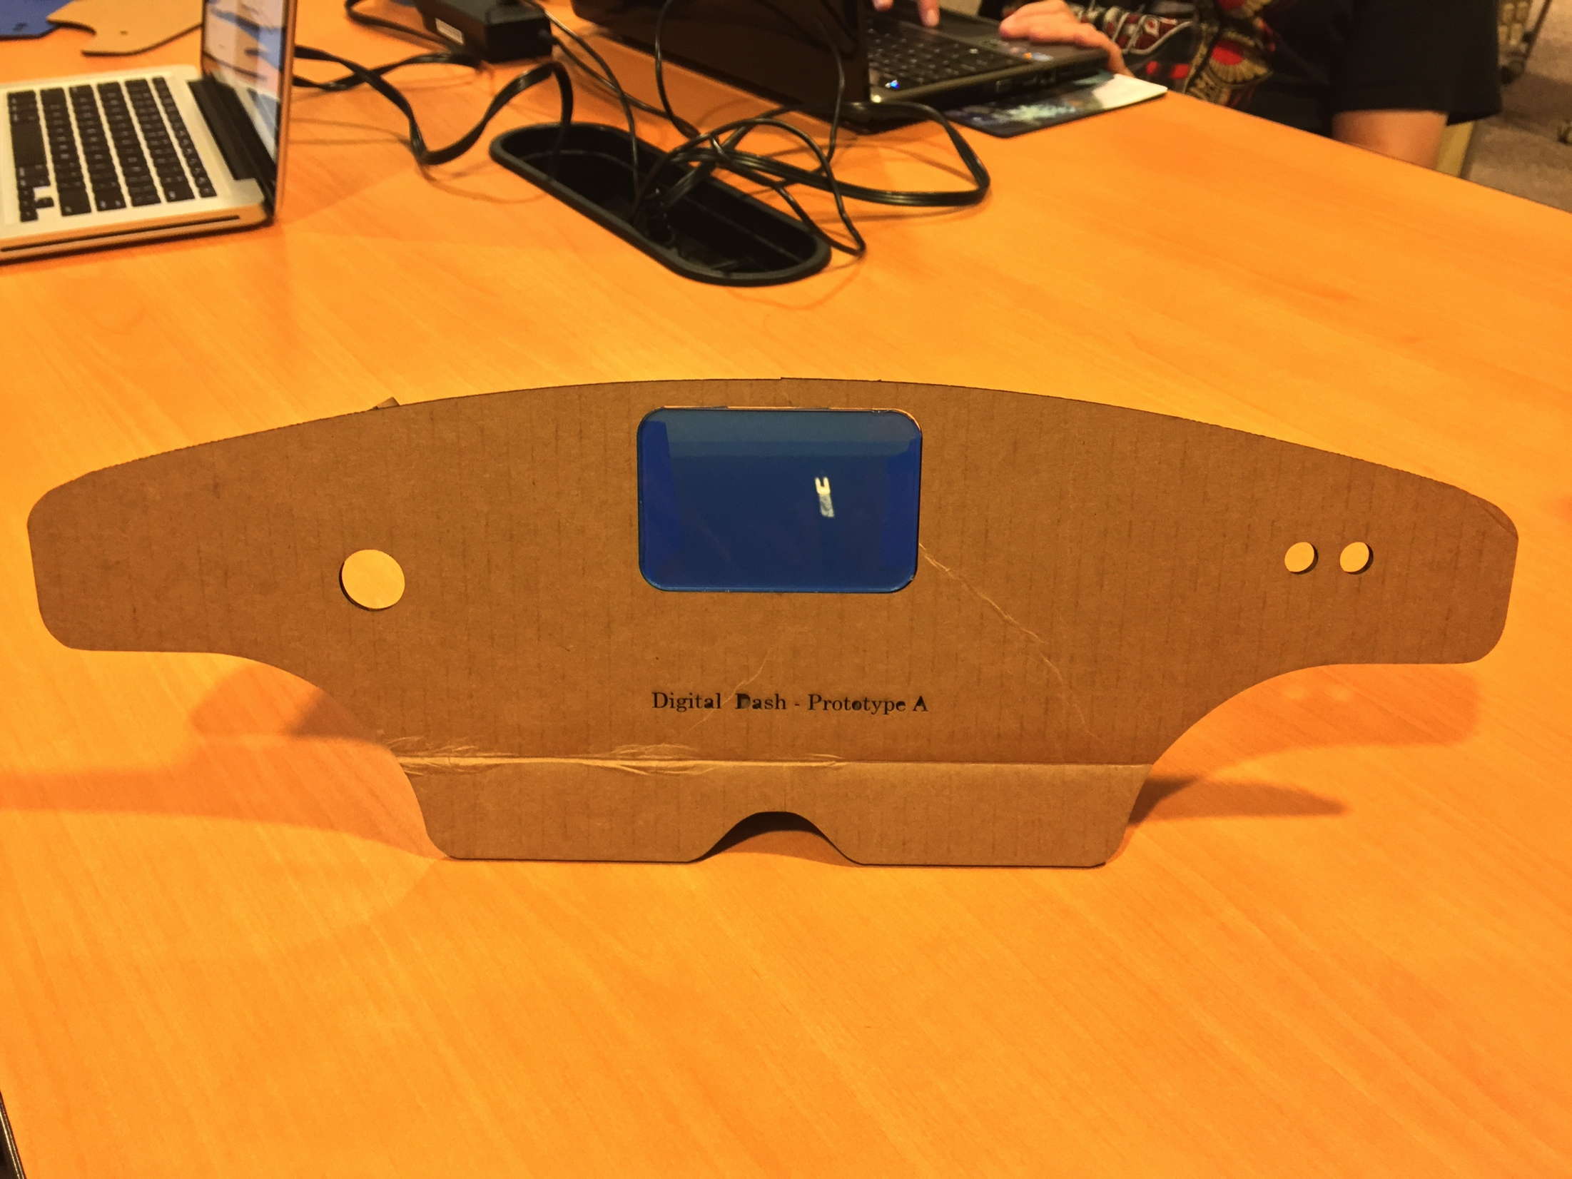
Testing
Demo Unit
Electric Vehicle
Analog inputs to simulate vehicle
Capstone poster session
FLAWLESS VICTORY
PLACEHOLDER PICTURES
Demo Unit
Electric Vehicle With Digital Dashboard
Notes:
Slide Purpose: Talk about demo unit?

Slide 12
Reproducibility
Hardware
Custom board schematics on Github – order through your favorite PCB manufacturer
Software
Very specific to vehicle components
Enclosure
Must be water resistant
We suggest a 4D Systems Screen
Note GUI sizing may need to be changed
Message IDs WILL need to be changed if components differ
Develop code and program from the Arduino IDE
The file used to laser cut acrylic in Inkscape is also on Github
Notes:
Slide Purpose: Show how to reproduce a unit
Scheduled FOR DELETION

Slide 13

Documentation
Software code
Schematics and layouts
Reproduction instructions
Development roadblocks, milestones and progress meetings
Budget, bill of materials and schedule
Test plans
Notes:
Slide Purpose: Show what documentation we have

Slide 14
Future Revisions
Revision 2.0
Software
Enclosure
Mainboard
Polling Based
Smaller
Programming Circuit
LCD Header
Microprocessor with more CAN mailboxes
Notes:
Slide Purpose: Show what we could improve

Slide 15
Conclusion
Get clarification early and often
Check basic functionality of the hardware and software early in the development process
Check the wiring
Create a simulation program for testing when the official test vehicle is not operational
Don't duel unless you are willing to risk being sent to the shadow realm
Notes:
Slide Purpose: wrap this up

